Slide 1
Recitation 7
File IO

Slide 2
Next several homeworks build on each other to help with project 2

Slide 3
How to represent files in C++?
Using the fstream library
#include <fstream>
ifstream objects for reading input files:
ifstream myFile;
myFile.open(“someFile.txt”); // Now we can do things with myFile!
// do something with myFile...
myFile.close(); // Close connection to myFile

Slide 4
Useful functions for file I/O
FILE_NAME.is_open();
Returns true if FILE_NAME is open
getline(FILE_NAME, STRING_NAME);
Extracts characters from FILE_NAME until a newline character (‘\n’) occurs, and stores them into STRING_NAME
int i = stoi(STRING_VALUE);
Converts a string STRING_VALUE to an integer, in this case, storing it in i
Everything read from a file is a string!
Check out other functions such as stod, stof etc.
Experiment with ‘<<’ and ‘>>’ operators.

Slide 5
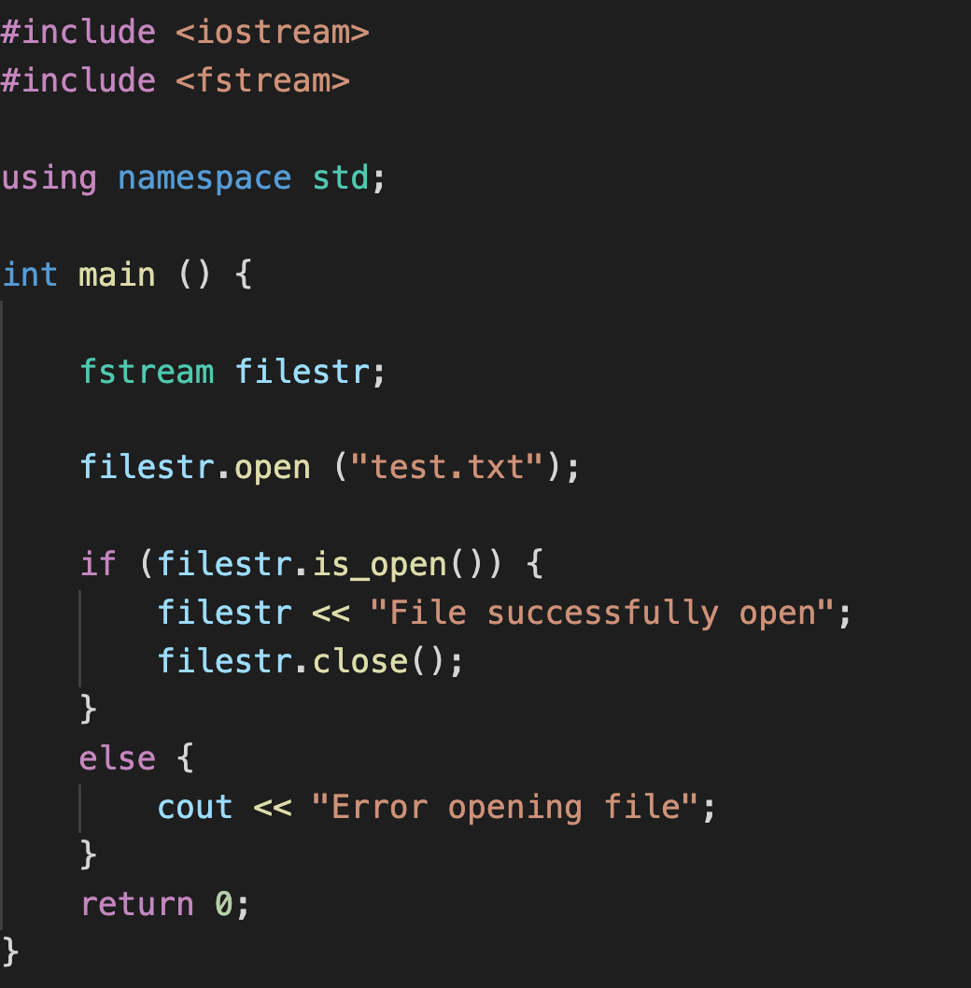
Sample Program: Opening a File

Slide 6
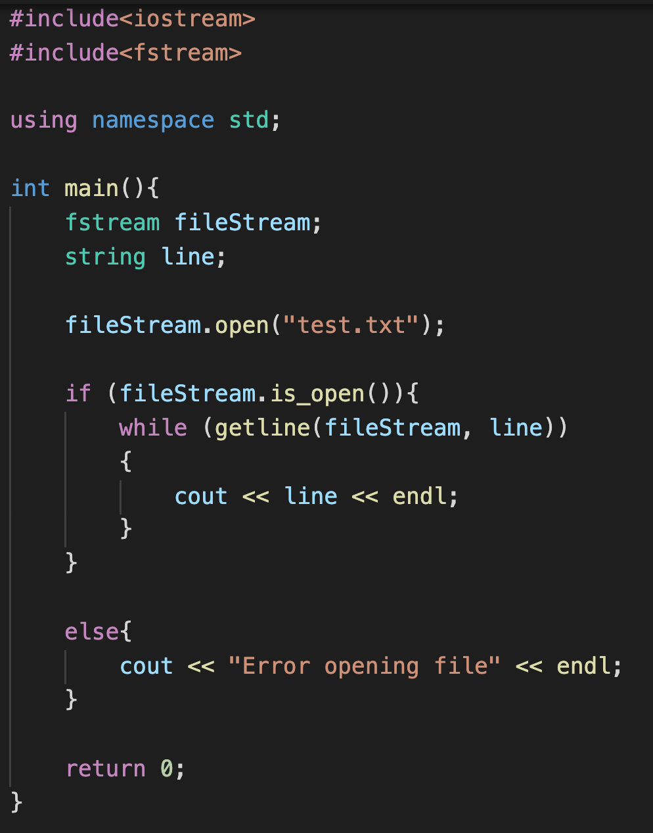
Sample Program : Iterate line by line

Slide 7
Reminder
Homework 6 due on Saturday 6:00 PM
Project 1 Interview grading must be completed by this week. Email TA.

